Slide 1
Attention Is All You Need (Transformer)
강은주
1679ej@g.skku.edu
Computer Vision
2023/03/28

Slide 2

Chat GPT
Transformer: 자연어처리, 특히 기계번역
RNN & CNN 을 전혀 사용하지 않고 self-attention mechanism만 사용
Multi-head attention을 통해 문장 내의 sequence에 대한 정보를 병렬처리 가능– parallelization

Slide 3
Contents
Limits on previous works
Attention – Self Attention & Multi-head Attention
Architecture of Transformer
Results
Summary – Why Self Attention ?

Slide 4
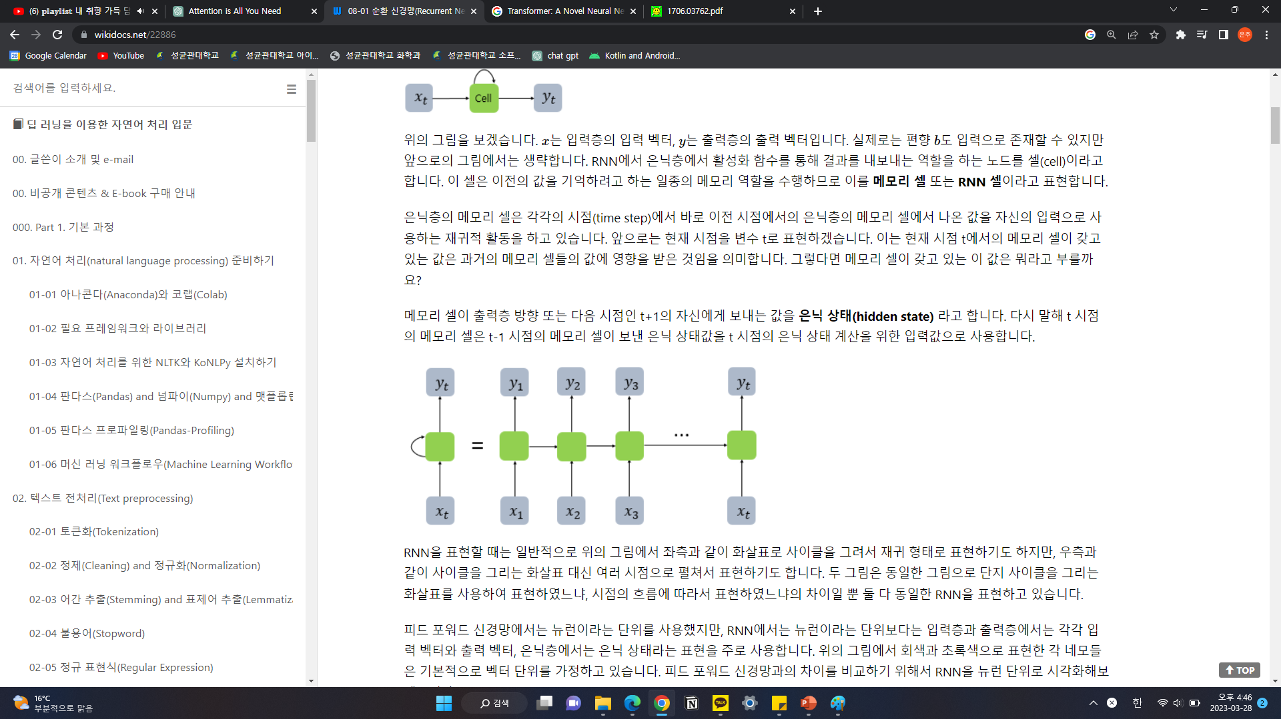
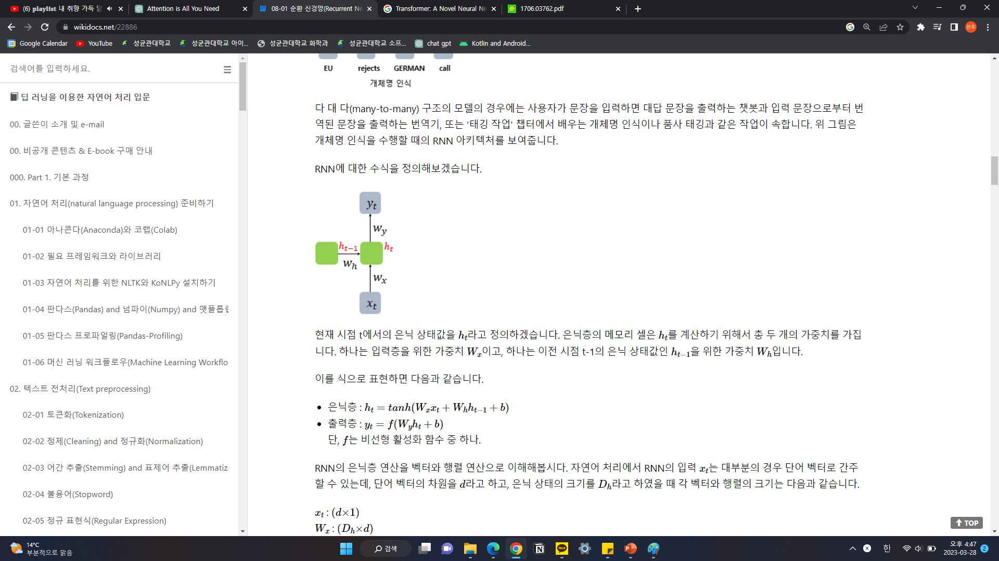
Limits of previous works
Recurrent Neural Network (RNN)
재귀 신경망(Recursive Neural Network)과는 다른 개념
은닉층의 노드에서 나온 결과값을 출력층 뿐만 아니라 다시 은닉층 노드의 다음 계산의 입력으로도 보냄
Notes:
은닉층의 노드에서 활성화 함수를 통해 나온 결과값을 출력층 방향으로도 보내면서, 다시 은닉층 노드의 다음 계산의 입력으로 보내는 특징을 갖고있습니다

Slide 5
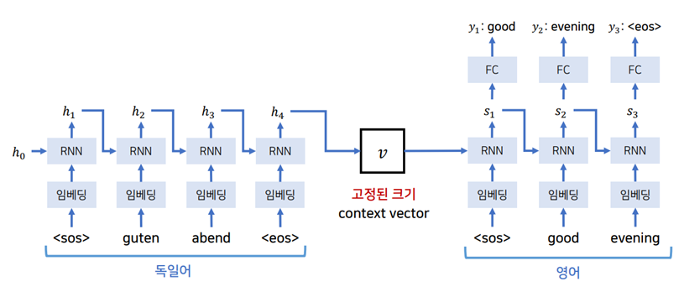
Limits of previous works
Seq2Seq 모델의 한계
소스 문장을 context vector v 하나로 압축해야 함
디코더는 소스 문장에 대한 정보를 v를 통해 한번만 참고
Notes:
문장에 대한 정보가 고정된 크기의 context vector 하나로 압축되어 있음
계속 hidden state가 갱신 -> 이전 정보들을 잘 담지 못하는 정보 손실의 문제

Slide 6
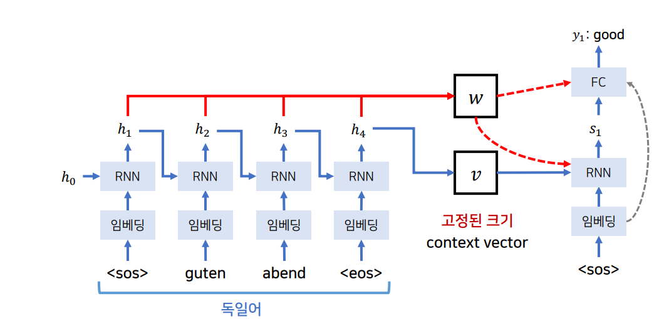
Limits of previous works
Seq2Seq 모델의 한계
Attention 개념의 등장: 디코더는 인코더의 모든 출력(output)을 참고
여러 h 중에서 s가 어떤 h과 가장 연관성이 높은 지 계산하여 가중치를 부여

Slide 7
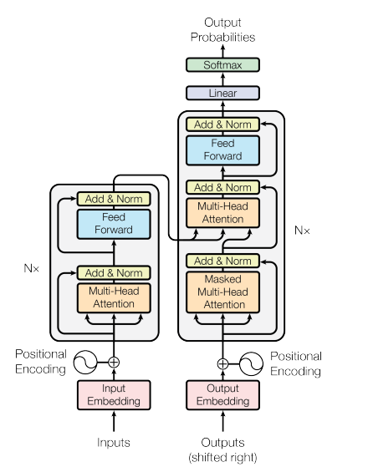
Architecture of Transformer

Slide 8
Architecture of Transformer
Encoder의 output에 대한 attention 연산 수행
N= 6
Residual Connection
Masking
Attention Layer
문장 내에 위치 정보 전달
Notes:
Attention – self attention & multi-head attention
Positional encoding
디코더에 인코더 아웃풋 반영
Feed forward
masking

Slide 9
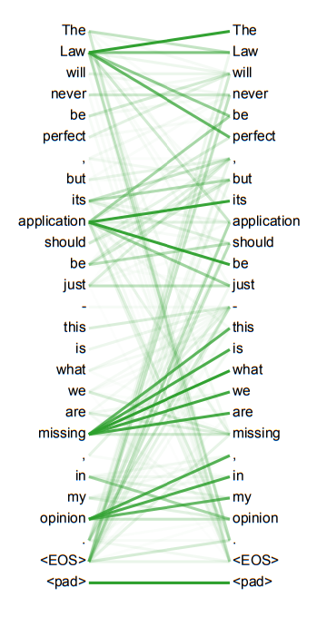
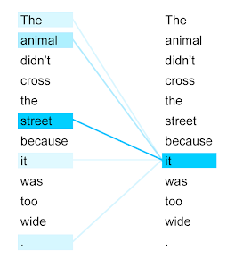
Attention
Self-Attention
한 문장 내에서 각 단어가 다른 단어와 얼마나 연관있는지 계산
Query, key, value vector로 변환되어 각 query-key pair에서 value에 얼마나 가중치를 두어야 하는지 attention score를 계산
Notes:
매번 입력 문장에서 각 단어가 다른 어떤 단어와 연관성이 높은 지 계산
< chat GPT>
In the context of natural language processing, self-attention is used to capture the relationships between different words in a sentence or sequence. By computing self-attention scores between all pairs of words in a sequence, the network can determine which words are most important for predicting the next word or generating the output sequence.
In a self-attention mechanism, each input element (e.g. a word or a pixel in an image) is transformed into a query, a key, and a value vector. These vectors are then used to compute an attention score between each query and key pair, which determines how much weight to give to each value vector. The resulting weighted sum of the value vectors represents the self-attended output.
Self-attention has shown to be particularly effective for sequence-to-sequence tasks such as machine translation and text summarization, where the network must generate an output sequence based on an input sequence of variable length. The Transformer architecture, which relies entirely on self-attention, has become a popular choice for many NLP tasks due to its ability to capture long-range dependencies and its computational efficiency.

Slide 10
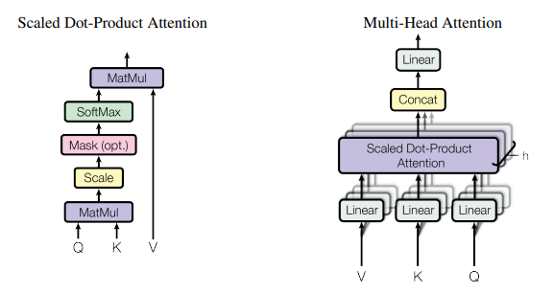
Attention
Multi-Head Attention
Multi-Head Attention을 통해 소스 문장의 여러 부분을 동시에 처리 가능 -> 병렬 처리
Ex. 한 head는 syntactic structure에 집중, 다른 head는 semantic relationships에 집중
Notes:
< chat GPT>
Multi-head attention is an extension of the self-attention mechanism used in neural networks that allows the network to attend to different parts of the input sequence simultaneously. In multi-head attention, the input sequence is transformed into multiple representations, each of which is learned by a separate "head" of the attention mechanism. The outputs of these heads are then concatenated and transformed into the final output.
In the context of natural language processing, multi-head attention can be used to capture different aspects of the input sequence. For example, one head may attend to the syntactic structure of the sequence, while another head attends to the semantic relationships between words. By attending to different aspects of the input sequence in parallel, multi-head attention can improve the performance of neural networks on tasks such as machine translation and text summarization.
The key idea behind multi-head attention is to allow the network to attend to different parts of the input sequence at different levels of abstraction. Each head of the attention mechanism is responsible for learning a different representation of the input sequence, which is then combined to produce the final output. This allows the network to capture complex relationships between the elements of the input sequence, while still maintaining a high level of interpretability.
Multi-head attention was first introduced in the Transformer architecture, which is now widely used in many NLP tasks. The ability of the Transformer to effectively capture long-range dependencies and attend to different parts of the input sequence simultaneously has made it one of the most popular neural network architectures for sequence-to-sequence tasks.

Slide 11
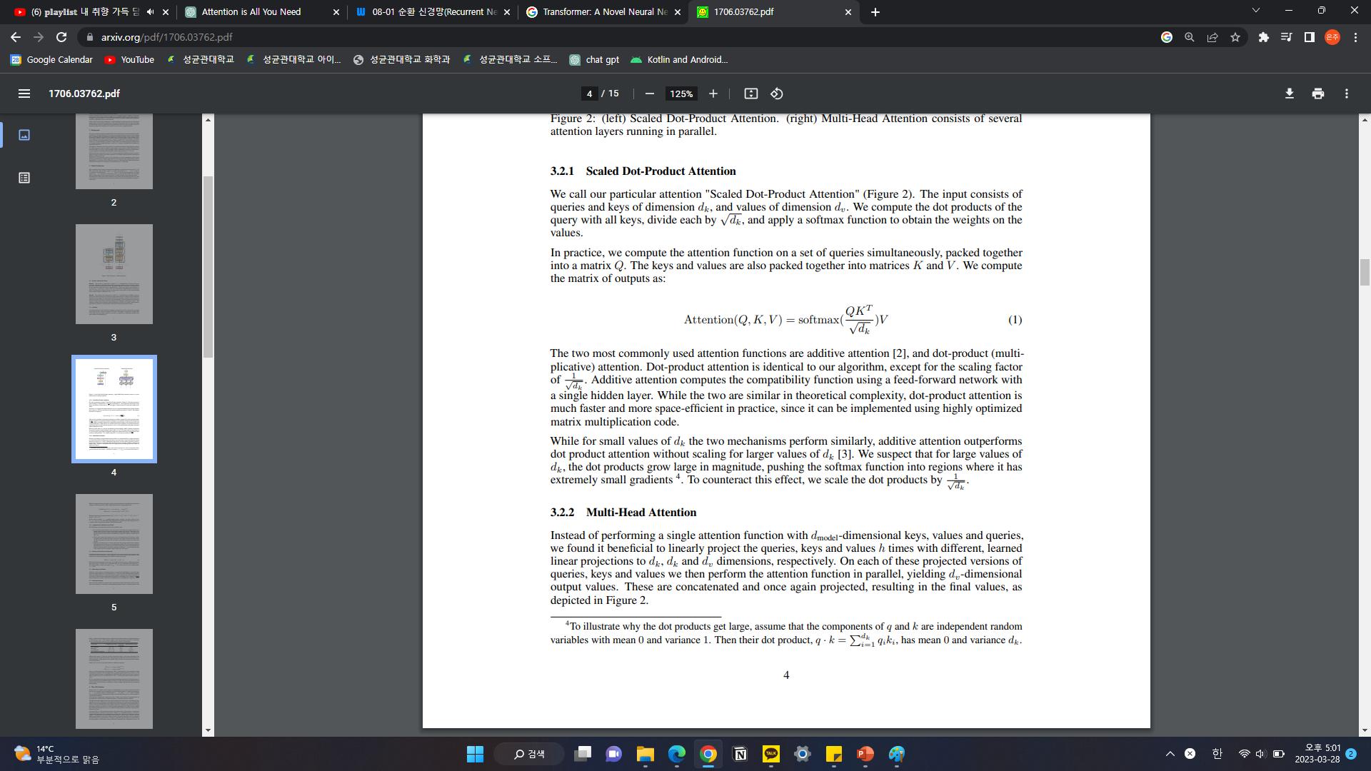
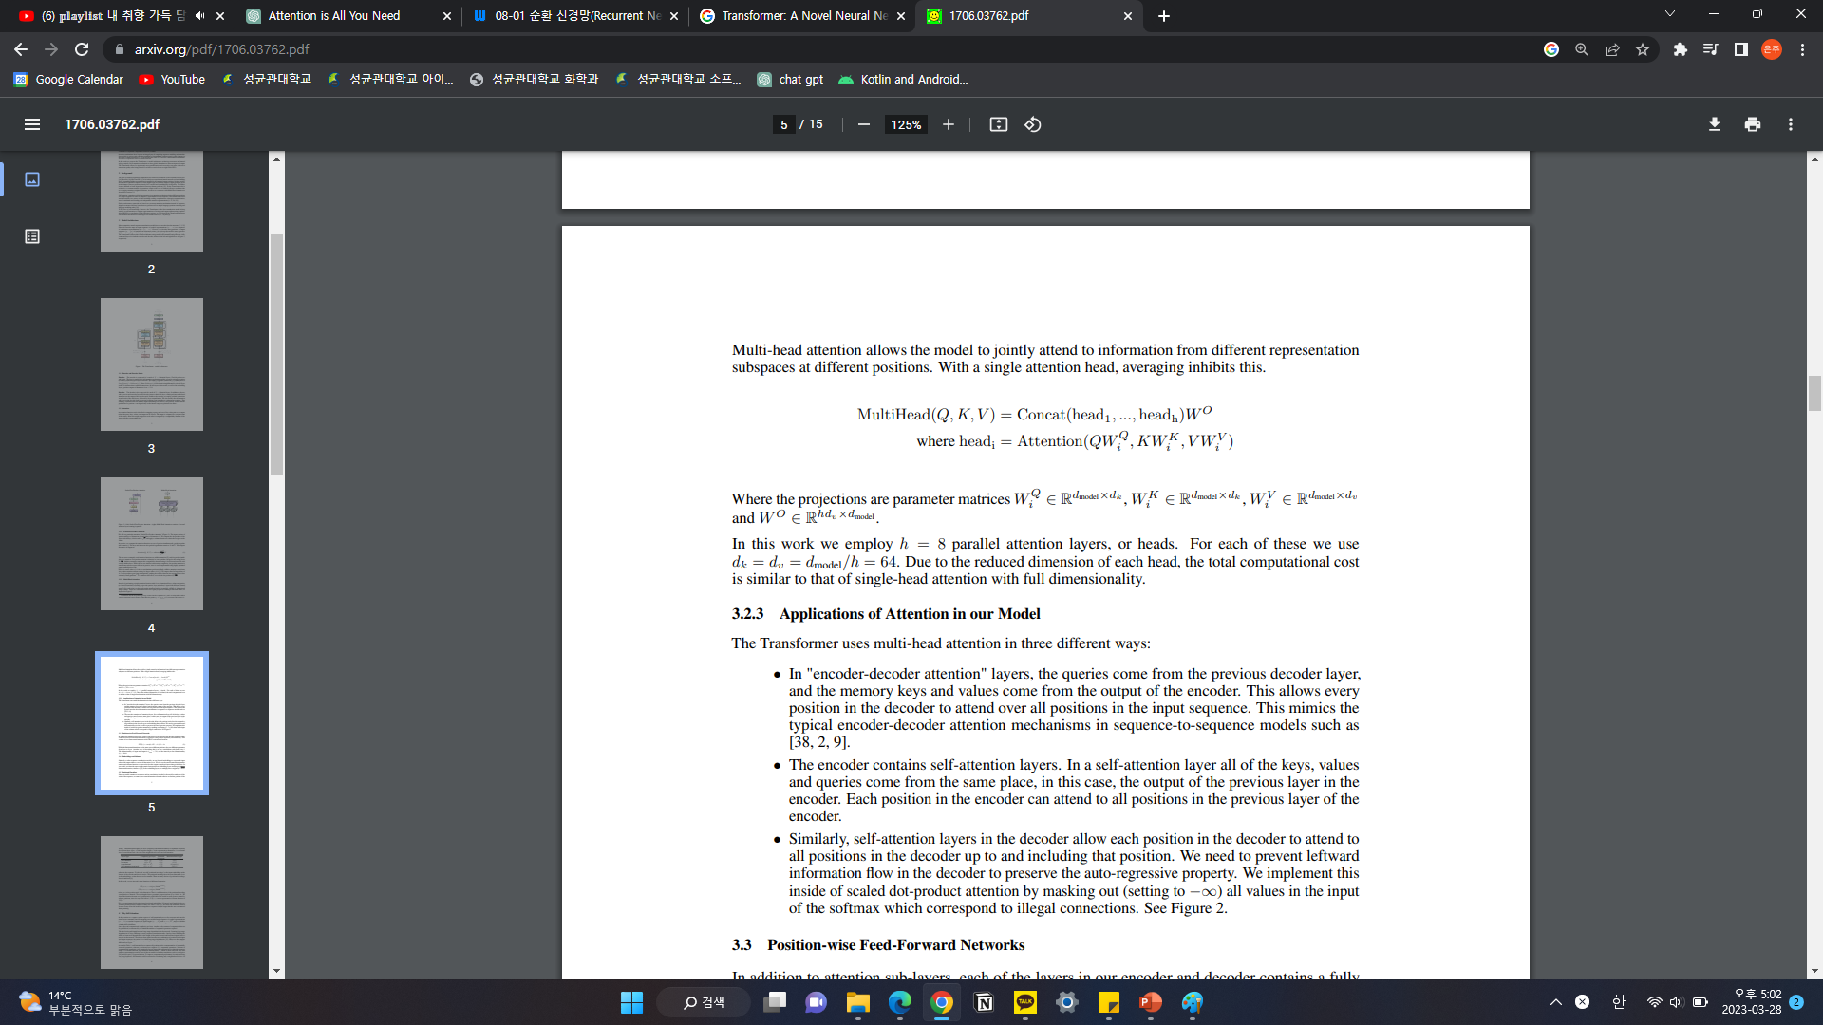
Attention
Multi-head Attention

Slide 12
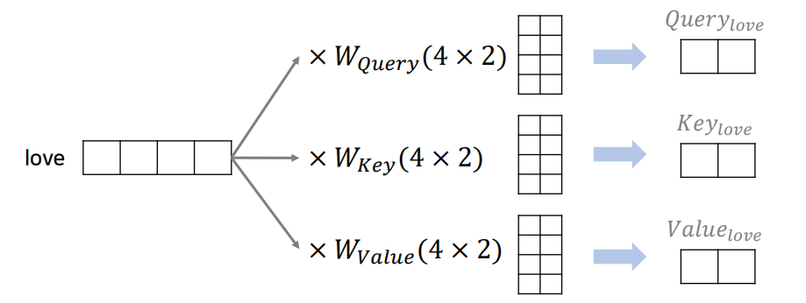
Attention
Multi-head Attention
Ex. I love you 라는 문장
Query, Key, Value 형성

Slide 13
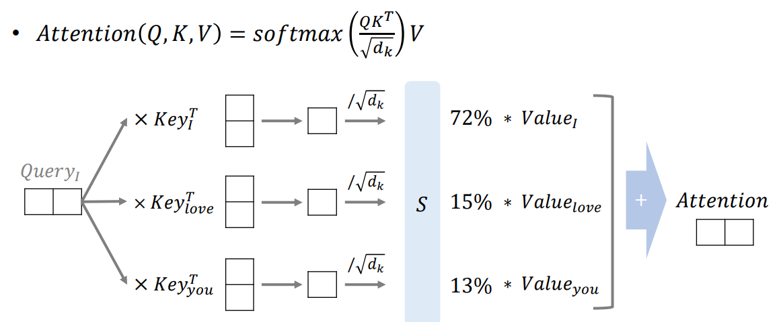
Attention
Multi-head Attention
‘I’를 ‘I’, ‘love’, ‘you’ 에 대해서 연산 수행
√DK 나누는 이유: dot product 값이 커지면 soft max에서 정보 손실이 발생하므로 이를 상쇄하기 위해서

Slide 14
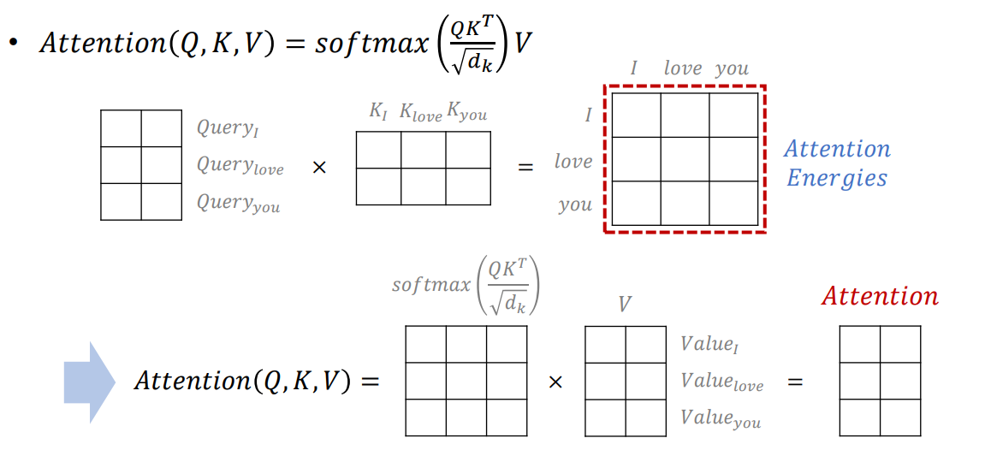
Attention
Multi-head Attention
이러한 dot-product attention은 행렬을 이용해서 빠르게 연산 가능

Slide 15
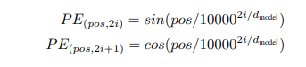
Transformer
Positional Encoding
RNN 없이 Attention만 하면 문장 내 각 단어에 대한 위치 정보가 없음 (sequence X)
따라서 positional encoding을 통해 sequence 정보 반영
Positional embedding을 사용해도 큰 차이 없음
Notes:
< chat GPT>: positional encoding과 embedding의 차이
Positional encoding and positional embedding are both techniques used in natural language processing (NLP) to incorporate the positional information of words in a sentence or sequence into the input representation. However, they differ in their implementation and purpose.
Positional encoding is a technique used in the Transformer architecture to add positional information to the input sequence. It is a fixed function that adds a positional encoding vector to each input vector, which provides information about the position of the word in the sequence. The positional encoding vector is computed using a mathematical formula that incorporates the position of the word in the sequence and the dimension of the input vector. The purpose of positional encoding is to provide the model with information about the order of the words in the sequence, which is necessary for the self-attention mechanism to work effectively.
On the other hand, positional embedding is a type of word embedding that incorporates the positional information of words into the embedding vector itself. Unlike positional encoding, which adds a fixed vector to each input vector, positional embedding adds a unique vector for each position in the sequence. The embedding vector is then concatenated with the word embedding vector to form the final input representation. The purpose of positional embedding is to provide the model with information about both the meaning of the word and its position in the sequence.
In summary, positional encoding is a fixed function that adds a vector to each input vector to provide positional information, while positional embedding is a technique that incorporates positional information into the word embedding vector itself. Both techniques are used to provide the model with information about the position of words in the sequence, which is important for many NLP tasks.

Slide 16
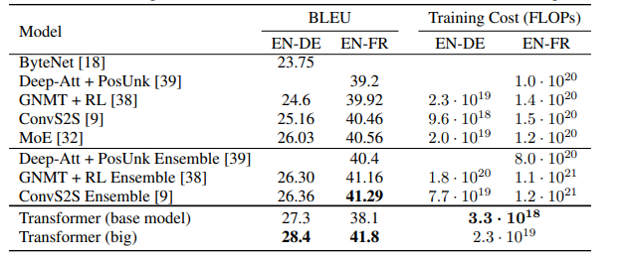
Result
Training

Slide 17
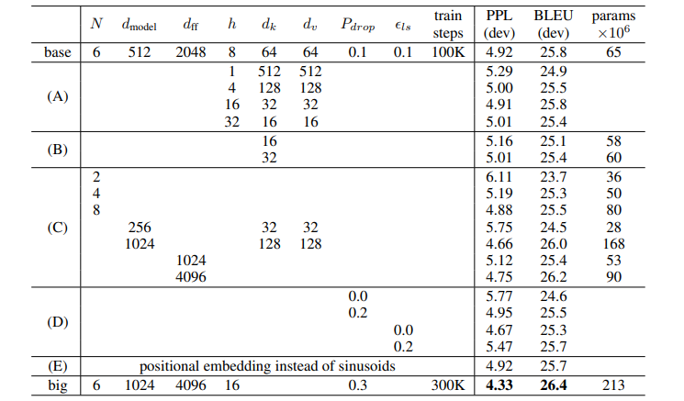
Result
Variation

Slide 18
Why Self Attention
Layer 당 연산량 감소
병렬 연산 시 연산량 감소
멀리 떨어져 있는 단어들도 연결지어 학습하기 용이
Notes:
< chat GPT>: why use self attention in transformer
Self-attention is used in the Transformer architecture for several reasons:
Capture Long-Range Dependencies: Self-attention allows the Transformer to capture dependencies between different parts of the input sequence, even if they are far apart. This is particularly important for NLP tasks where the meaning of a word can depend on the entire context of the sentence.
Reduce Computation: Traditional neural network architectures like recurrent neural networks (RNNs) process the input sequence sequentially, which can be computationally expensive and slow. Self-attention allows the Transformer to process the entire sequence in parallel, reducing the overall computation time.
Easy to Parallelize: The self-attention mechanism is highly parallelizable, which allows the Transformer to take advantage of modern hardware such as GPUs and TPUs. This makes it possible to train and deploy large Transformer models on large datasets.
Adapt to Variable-Length Input Sequences: Unlike RNNs, which require fixed-length input sequences, the Transformer can handle variable-length input sequences with ease. This makes it well-suited for tasks such as machine translation and text summarization, where the length of the input sequence can vary widely.
Overall, self-attention allows the Transformer to capture complex dependencies between the elements of the input sequence, while still maintaining a high level of parallelism and computational efficiency. This has made it a popular choice for many NLP tasks and has led to significant improvements in performance on benchmarks such as machine translation and text generation.

Slide 19
Reference
https://arxiv.org/pdf/1706.03762.pdf
https://wikidocs.net/22886
https://www.youtube.com/watch?v=AA621UofTUA
https://github.com/ndb796/Deep-Learning-Paper-Review-and-Practice/blob/master/lecture_notes/Transformer.pdf

Slide 20


